Slide 1

CodeU Trial class Welcome!
The class will start shortly

Slide 2
Agenda for today’s class
Introduction
Pop Quiz
01
02
Let’s get to know each other!
To introduce the world of coding
Fun Facts about Programming
Navigating Visual Studio Code
03
04
You’ll become the programming expert
Learn to use the app like a pro!
Your first code!
Conclusion
05
06
CodeU Robot
Fun activities to learn Python code
Wrap-up and questions

Slide 3
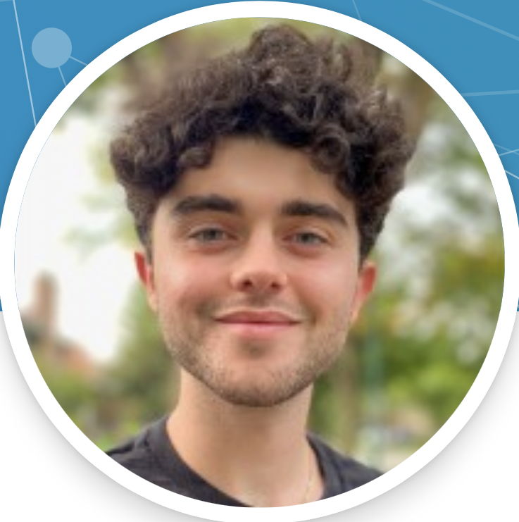
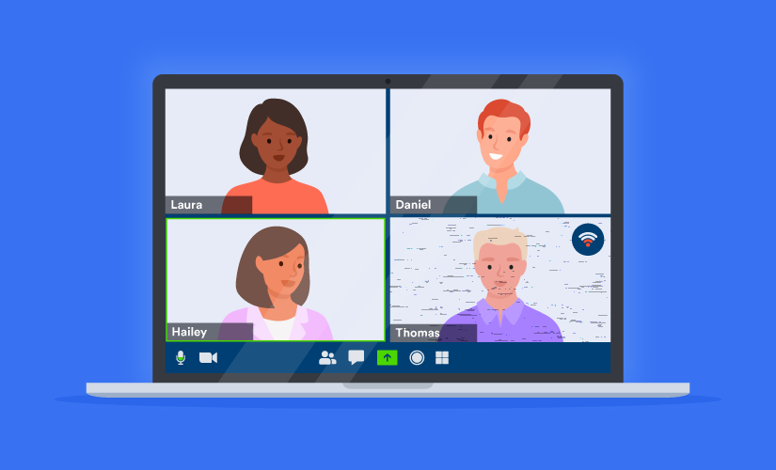
Introduction
01
02
Hi! My name is Eran
How about you?
I will be your tutor for today’s lesson!
What is your name, in what city do you live and how old are you?

Slide 4
Pop Quiz!
A. Building a computer for video games
What is programming?
B. Writing a secret message for computer hackers
C. Creating a set of instructions that tell a computer how to perform a task
D. Programming sentences to load a computer

Slide 5



What is Programming?
Think of a chore you have to do at home
Like taking out the trash
You have set of rules to follow
Emptying the trash
Putting new bag in
Putting the trash in the bin
Creating a set of instructions that tell a computer how to perform a task.
You might run into obstacles
What happens if you don’t have anymore garbage bags?
Your human brain is able to find a solution, like going to the store to buy new ones.
But computers don’t have the same capabilities, you need to provide the exact instructions and conditions to solve different situations.

Slide 6
Pop Quiz!
A. A mechanical watch
What everyday object around you uses programming?
B. A light bulb
C. A Bathtub
D. iPad

Slide 7
Pop Quiz!
A. Traffic lights
What everyday object around you uses programming?
B. The Zoo
C. Video games
D. All of the above

Slide 8

Pop Quiz!
A. Tennis for two
What was the first ever video game created?
B. Pong
C. Spacewar
D. Fortnite
Notes:
The inventor of the first video game was a Nuclear Physicist! He inveted the game Tennis for two to attract more people at his booth during science fair. Every year, he participated in the fair and realized that no one was paying attention because on the complicated terms and concepts. He thought that by having a game people would be more interested, and he was right! His booth was the most popular
https://www.retrogamedeconstructionzone.com/2021/08/the-tennis-for-two-simulator-tets.html

Slide 9
Pop Quiz!
A. 1958
In what year was the first video game invented?
B. 1999
C. 1989
D. 1950

Slide 10
What are Programming Languages?
Definition
Application in the world
Language used to write instructions for the computer.
There are many languages used for every type of task
Zoo keepers
Video games
iPads
Traffic lights
Each language has different rules, syntax and structures, just like French and English
Ex: Binary code
100011001
110000011
100010000
2 types:
Low-level languages
Easy for the computer to read, but very hard for humans.
High-level languages
Use English and mathematical symbols to communicate instructions.
Ex: Python
print (“Hello World”)

Slide 11

Pop Quiz!
A. 50
How many programming languages are there?
B. 700
C. 350
D. 1000

Slide 12





Fun Facts!
Web developer
Did you know?
Writing code to design websites
You need to know programming to be an astronaut!
Video game developer
Creating and editing video games
But that is not the only career opportunity you get with programming!
Cybercrime investigator
Investigate cybercrimes and track hacks

Slide 13




Fun facts!
Did you know?
The first programmer was a woman named Ada Lovelace!
She wrote the first algorithm designed for a computer.
There were many other significant women in the programming world such as Grace Hopper who was a pioneer in the engineering of the first computer.
The both showed resilience and ingenuity. Which are a few of the important characteristics any programmer should have.
Resilience
Creativity
The patience and passion to create a code
Solving problems by thinking outside the box
Ingenuity
Lifelong Learner
The ability to handle a problem in a logical, analytical way
Always willing to learn new things

Slide 14
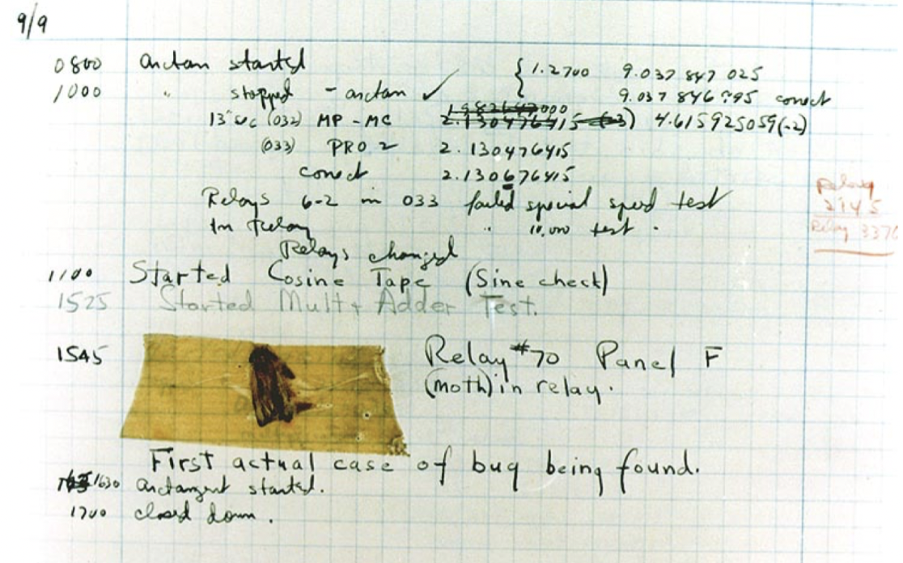
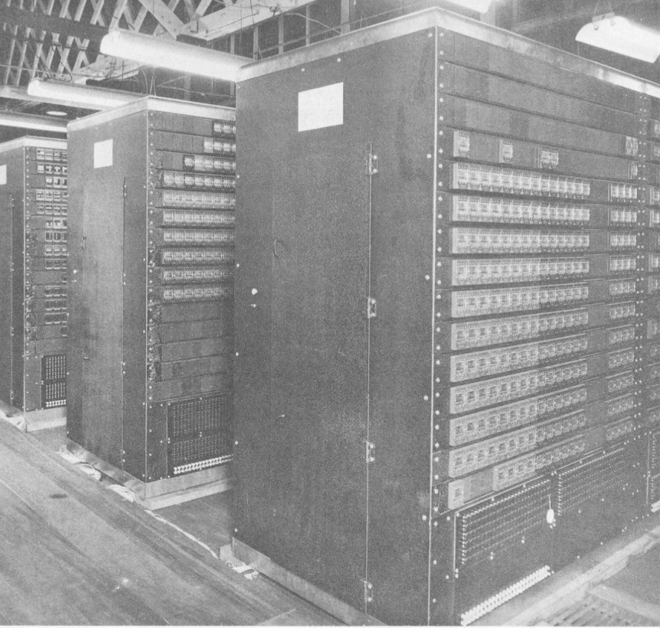

Fun Facts!
Did you know?
The first computer bug was an actual bug!
On September 9, 1947, the computer at the Harvard Laboratory started to malfunction. The error was due to a moth trapped inside the gigantic computer!

Slide 15
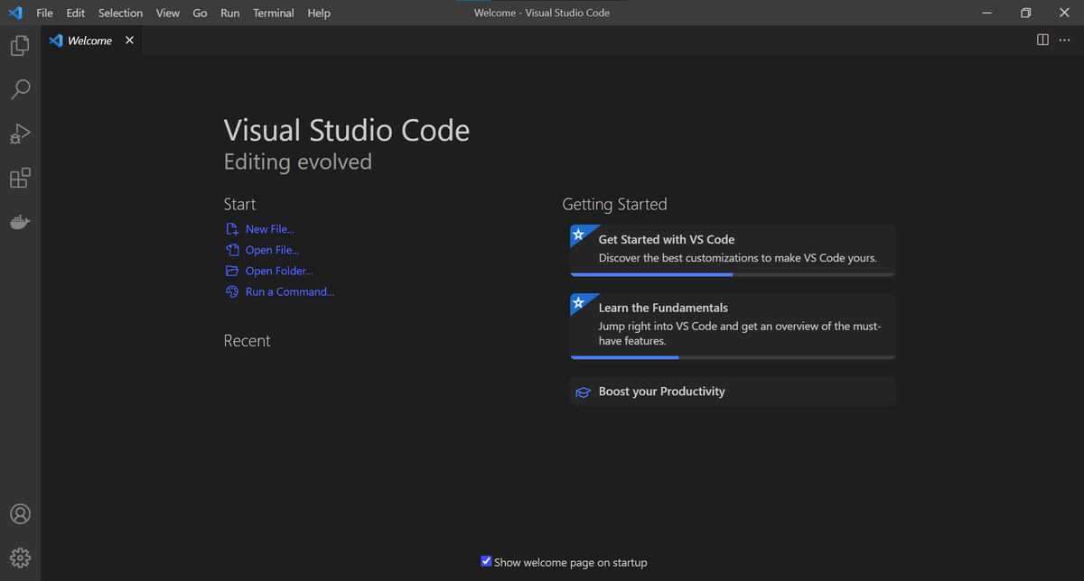
Navigating Visual Studio Code

Slide 16
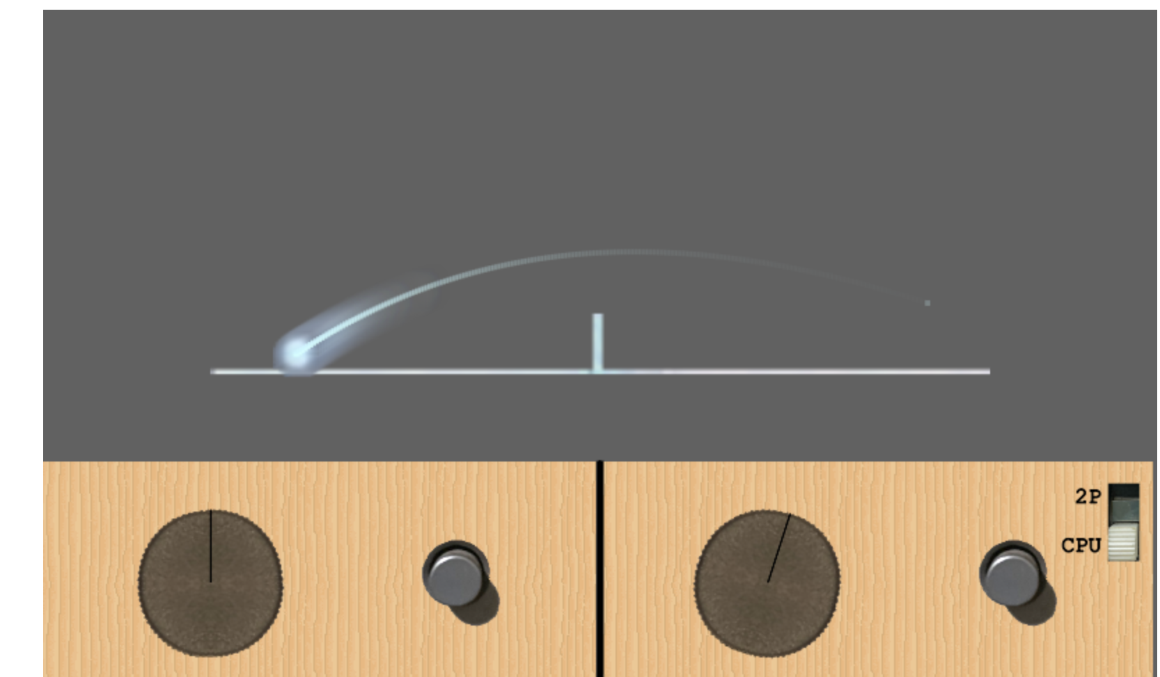
Time for a break!
We’ll be back in 20 minutes!
If you don’t know what to do, I invite you to go try the first video game ever!
The link is in the zoom chat
Notes:
https://www.retrogamedeconstructionzone.com/2021/08/the-tennis-for-two-simulator-tets.html

Slide 17
Your first code!
01
Type in the following:
Comments
Print(“Hello World!”)
02
Comments are used to annotate your code and to write down notes that you want the interpreter to ignore
Run the program
To run the program in Visual Studio code, …
03
Start comments using #
What do you see displayed?
Ex: # this comment will be
ignored
Note that the quotation marks are not included

Slide 18

You can use Python as a calculator
+/-
/
Additions and subtractions
Divisions
print(10/2)
print(“apple”/2)
print(5+5)
print(5-5)
print(“5+5”)
Errors
*
Multiplications
Just like you could make a grammar mistake in your homework, it is very easy to make a mistake while writing code.
Errors in code are what produce bugs in the program. With practice, we’ll learn together how to debug a code.
print(5*2)
print(“apple”*3)
print(“apple*3”)

Slide 19



You can use Python as a drawing pad
Import turtle module
1
import turtle
Turtle Module
2
Create turtle
Python module that allows you to draw shapes using commands
Use any name you like
Ex: eran = turtle.Turtle()
3
Move turtle
Imagine a turtle moving across a piece of paper holding a pen, so that it leaves a trail of ink behind
eran.forward(50)
This moves eran by 50 pixels
.forward(x) is a type of method you can use on a turtle.
You can also use .backward(x), .left(a) and right(a)

Slide 20

List of more turtle methods
01
.penup()
.circle(x)
05
Pull the pen up so no drawing is made when the turtle is moving
Draws a circle with the radius x
02
.pendown()
.color(“blue”)
06
Pull the pen down to start drawing when the turtle is moving
Changes the color of the line. See next slides for colors
03
.goto(x, y)
.shape(“arrow”)
07
Moves the turtle to the position x,y
Changes the tip of the turtle to another shape. See next slides for more shapes.
04
.speed(”slow”)
.pensize(x)
08
Changes the speed of the turtle. Can use “slow”, ”fast”, “fastest”
Changes the thickness of the line to width x.

Slide 21
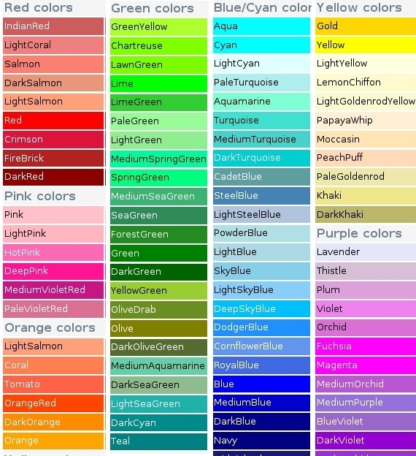
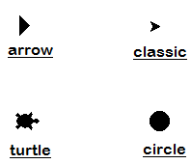
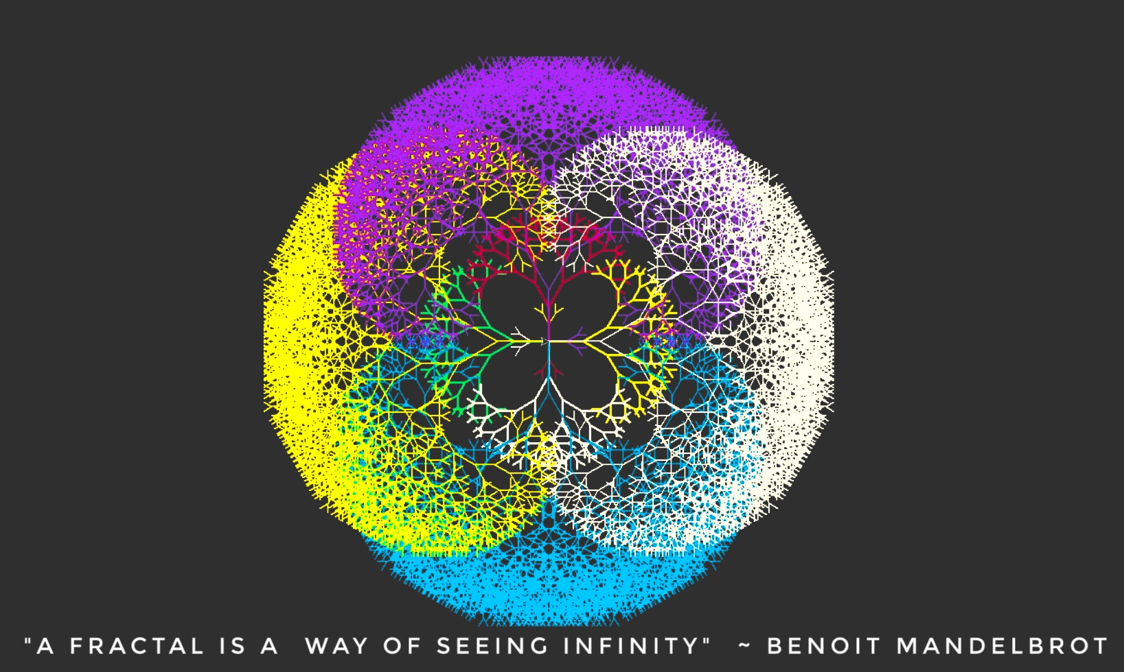
Shapes
Colors
Colors and Shapes
“arrow”
“turtle”
“circle”
“square”
“triangle”
“classic”

Slide 22

Your first turtle drawing!
Since the Olympics are starting soon, let’s use the turtle module to draw the logo!
Reminders:
.penup()
.pendown()
.goto(x, y)
.circle(radius)
.color(“color”)
.forward(x)
.right(x)
Steps to creating our drawing
Import turtle
Create turtle
Change pen size to 6
Set starting point at (-200, 100)
Draw first circle (“blue” with radius 50)
Move to second circle (forward 110)
Draw second circle (“black” with radius 50)
Move to third circle (forward 110)
Draw third circle (“red” with radius 50)
Move to fifth circle (left 180, forward 55, right 90, forward 50, left 90
Draw fifth circle (“green” with radius 50)
Move to fourth circle (forward 110)
Draw fourth circle (“yellow” with radius 50)

Slide 23
Conclusion
Wrap-up
what is computer programming? | Creating a set of instructions for ____?
programming in our lives | What is an example of an object that uses programming?
first video game | What was the name of the first ever video game?
programming languages | What language did we use today?
fun facts | What is the type of bug that stayed trapped in the computer?
your first code! | What did our code print?
calculator exercise | Could we divide the word “apple”?
turtle drawing | How many rings are there?

Slide 24




Thank you!
Does anyone have any questions?
Next available class
Please contact us to book the class or to schedule for a different date.
Phone:
(438) 391-9106
Email:
hello@codeu.ca

